Slide 1
Seed Health Testing for Medicinal Plants is a Must: Case Studies Anise, Fennel, Fenugreek and Black Cumin Seeds
Mohamed A. Elwakil
Prof. Emeritus of Plant Pathology, Mansoura Univ.,
El-Mansoura, Egypt, 35516
Web: mwakil.net
E-mail: mawakil@mans.edu.eg
ICPS 2015, Dubai

Slide 2
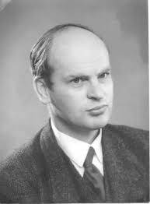
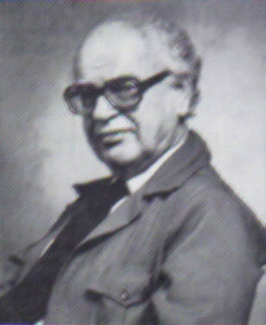
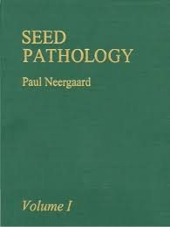
Background:
Seed –A Horse of Hunger or Source of Life “1985”
Dr. Paul Neergaard, The father of Seed-Pathology Science

Slide 3
Most seed-borne fungi have the potential to produce toxins
1st Statement
e.g:
Acremonium strictum
Alternaria alternata
Aspergillus species (A. flavus, A. parasiticus, A. fumigatus, A. niger, A. ochraceus, A. nidulans, A. tamari and A. versicolor)
Chaetomium globosum
Cladosporium cladosporides
Curvularia lunata

Slide 4
Continue
Fusarium species (F. equiseti, F. oxysporum,
F. pallidoroseum, F. solani and F. verticillioides)
Penicillium citrinum and Penicillium Chrysogenum
Stachybotrys chartarum and Stachybotrys atra
Verticillium dahliae and Verticillium albo-atrum

Slide 5
A- Habit characters (H.C.) of seed-borne fungi on seeds (stereoscopic microscopy)
2nd Statement: Seed Pathology Science
For
The Primary identification of associated fungi with seeds

Slide 6
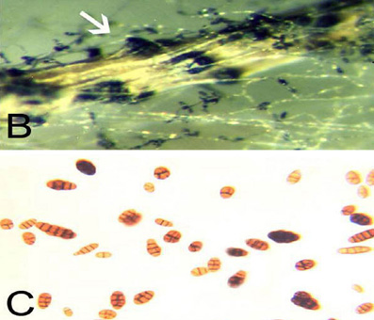
Fig. 1: H.C. of Alternaria radicina on anise seed.
Examples

Slide 7
Fig. 2: H.C. of Fusarium solani on anise seed.

Slide 8
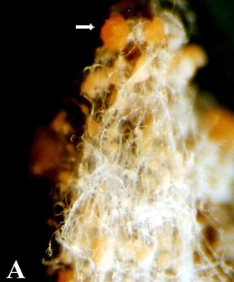
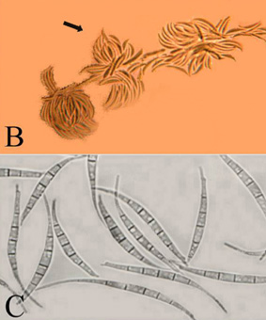
Fig. 3: H.C. of Fusarium equiseti on black cumin seed.

Slide 9
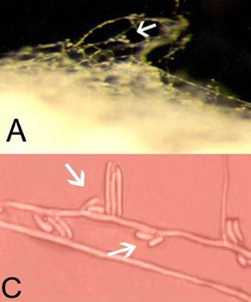
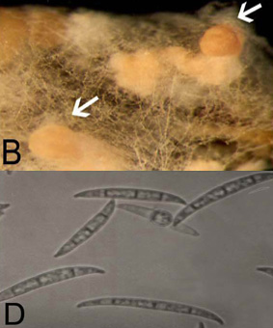
Fig. 4: H.C. of Fusarium oxysporum on fennel seed.

Slide 10
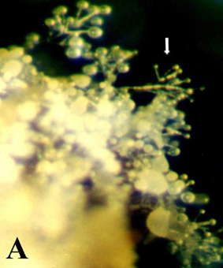
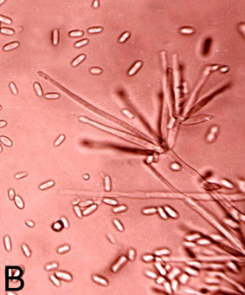
Fig. 5: H.C. of Verticillium dahliae on fenugreek seed.

Slide 11
Identification of most common mycotoxins produced by seed-borne fungi
3rd Statement

Slide 12
Aflatoxins (B1, B2, G1, G2)
Ochratoxin A
Cladosporin
Zearalenone
Fumonisins B1, B2
Trichothecenes (TCs)
Emodin
Patulin
Citrinin
Satratoxins, F,G,H
Mycotoxins tree

Slide 13
When using medicinal seeds infested or infected with seed-borne fungi able to produce toxins in our daily diets or medications, acute and chronic effects may occur including:
4th Statement
Hepatotoxicity
Teratogenicity
Mutagenicity

Slide 14
Resulting in:
Hepatitis
Hemorrhage
Immunosuppression
Hepatic carcinoma
Esophageal cancer
Kidney failure

Slide 15
5th Statement
Example 1
Seed-borne fungi and toxin they produce
Trichoderma spp.
Cephalosporium spp.
Stachybotrys spp.
Fusarium spp.
Myrothecium spp.
Verticillium porium
Trichothecium spp.
Trichothecenes
T-2
Nevalenol
Vomitoxin (Deoxynivalenol)
Anguidine (Diacetoxyscipenol)
Powerful inhibitors of protein synthesis

Slide 16
Example 2
Aspergillus parasiticus
Aspergillus flavus
Aflatoxins
B1
B2
G1
G2
Aflatoxicosis
Carcinogenic

Slide 17
Example 3
Penicillium spp.
(P. verrucosum)
(P. carbonarius)
Aspergillus spp.
(A. ochraceus)
(A. niger)
Ubiquitous
Ochratoxins
Ochratoxin A
Ochratoxicosis
Human Carcinogen

Slide 18
Example 4
Fusarium spp.
Gibberella spp.
Zearalenone
Estrogenic Syndrome
Potent estrogenic metabolite

Slide 19
Is seed health testing a must? Yes it is
6th Statement
Because
When one or more fungus of potential to produce toxins are present on or in seeds, serious implications for human health will, for sure, occur.
So far
Seed-borne fungi should be a component of the integrated commodity management program of the drug industry.

Slide 20
The Present Status
7th Statement
Lack of interest from the Drug industry.
Lack of Awareness of care given about Medicinal Seed Health Testing.

Slide 21
What are the methods recommended for seed-health?
8th Statement
The International Seed Testing Association (ISTA) has tests for seeds of different crops i.e.
Standard blotter test
Deep-freezing test
Agar plate test
The authors designed an alkaline seed-bed method for detecting the lurked seed-borne fungi.

Slide 22
9th Statement:
To absorb this fact, here is a case study
Recorded mycotoxin producing fungi on Fenugreek, Anise, Black cumin and Fennel
Genera and species | Frequency %
 | Fenugreek | Anise | Black cumin | Fennel
Acremonium strictum | 0 | 5 | 2 | 5.5
Alternaria alternata | 66 | 91 | 63 | 65
A. radicina | 0 | 50 | 0 | 10
A. tenuis | 2 | 0 | 0 | 0
Aspergillus flavipes | 2 | 5 | 10 | 2
A. fumigatus | 4 | 15 | 18 | 3
A. parasiticus | 4 | 5 | 4 | 3
A. candidus | 0 | 15 | 0 | 0
A. clavatus | 25 | 6 | 4 | 0
A. flavus | 60 | 52 | 48 | 67
A. nidulans | 38 | 54 | 32 | 38
A. niger | 56 | 74 | 32 | 75
A. ochraceus | 53 | 10 | 26 | 53
A. oryzae | 20 | 15 | 18 | 9.5
A. tamarii | 31 | 54 | 16 | 31
A. terreus | 2 | 12 | 14 | 2
A. versicolor | 0 | 0 | 4 | 25

Slide 23
Continue
Genera and species | Frequency %
 | Fenugreek | Anise | Black cumin | Fennel
Chaetomium elatum | 2.5 | 0 | 3 | 0
C. atrobrunneum | 3 | 5 | 0 | 0
C. bostrychodes | 0 | 10 | 0 | 7
C. globosum | 0 | 5 | 0 | 0
C. spirale | 3.5 | 0 | 0 | 0
Cladosporium cladosporioides | 9 | 12 | 16 | 30
C. herbarum | 1.5 | 5 | 4.5 | 12
C. oxysporum | 3 | 15 | 0 | 18
C. sphaerospermum | 1 | 0 | 0 | 5
C. tenuissimum | 4 | 10 | 5 | 2.5
C. uredinicola | 2 | 5 | 0 | 4

Slide 24
Continue
Genera and species | Frequency %
 | Fenugreek | Anise | Black cumin | Fennel
Curvularia lunata | 0 | 16 | 6 | 4
C. pallescens | 1 | 5 | 0 | 0
C. senegalensis | 2 | 0 | 0 | 0
Fusarium equiseti | 2.5 | 30 | 1 | 6
F. oxysporum | 13 | 16 | 6 | 31
F. pallidoroseum | 13 | 32 | 3 | 28
F. solani | 6 | 20 | 9 | 19
F. subglutinans | 0 | 15 | 0 | 0
F. verticillioides | 28 | 42 | 8 | 56
Mucor circinelloides | 0 | 3 | 0 | 5.5
M. hiemalis | 5 | 15 | 2 | 3
M. racemosus | 0 | 0 | 0 | 0
Myrothecium verrucaria | 0 | 7 | 1 | 9

Slide 25
Continue
Genera and species | Frequency %
 | Fenugreek | Anise | Black cumin | Fennel
Penicillium citrinum | 18.5 | 6 | 2 | 7
P. chrysogenum | 7.5 | 18 | 9 | 25
P. purpurogenum | 11 | 7 | 0 | 9
P. aurantiogriseum | 0 | 7 | 0 | 0
P. brevicompactum | 0 | 4 | 0 | 0
P. corylcphilum | 0 | 9 | 35 | 12
P. funiculosum | 10 | 2 | 0 | 0
P. janthinellum | 0 | 0 | 0 | 8
P. notatum | 0 | 0 | 0 | 5
P. spinulosum | 0 | 5 | 0 | 0

Slide 26
Continue
Genera and species | Frequency %
 | Fenugreek | Anise | Black cumin | Fennel
Rhizopus arrhizus | 3.5 | 0 | 0 | 0
R. oryzae | 2.5 | 10 | 13 | 22
R. stolonifer | 10 | 36 | 18 | 4
Stachybotrys atra | 3 | 42 | 0 | 4
S. chartarum | 0 | 20 | 67 | 6
Trichoderma hamatum | 3 | 12 | 0 | 0
T. harzianum | 0 | 1 | 2 | 6.5
T. viride | 1 | 4 | 0 | 4
Trichothecium rosum | 3 | 6 | 1 | 0
Verticillium albo-atrum | 5 | 19 | 0 | 10
V. chlamydosporium | 1 | 6 | 0 | 1
V. dahliae | 10 | 10 | 9 | 7
V. nubilum | 0 | 4 | 0 | 1

Slide 27
Our last words
Healthy Plant … Healthy Seed
Healthy Seed … Healthy People
Health People … Healthy Planet

Slide 28
Acknowledgments
I would like to thank Dr. Khalid Ghoneem for his efforts in compiling the data of our work.
My thanks also dedicated to Dr. Mohamed El-Metwally for his assistance in preparing the presentation.
Thanks to Wael Elwakil, Doctor of Plant Medicine Student at University of Florida for his reviews.

Slide 29
Massage from the Glorious Nelson Mandela

Slide 30
Thank you for your attention
This presentation is available on the internet when search for the title: Seed Health Testing for Medicinal Plants is a Must: Case Studies Anise, Fennel, Fenugreek and Black Cumin Seeds (Presentation)
All the best

